Slide 1

DEPARTMENT OF ARTIFICIAL INTELLIGENCE AND DATA SCIENCE ACADEMIC YEAR 2025 - 2026 SEMESTER III ARTIFICIAL INTELLIGENCE LABORATORY MINI PROJECT REVIEW Snake and Ladder Solver using BFS
REGISTER NUMBER | 211724007006
NAME | ABINAYA S
YEAR | 2
SECTION | A
FACULTY IN-CHARGE | Mrs. M. Divya

Slide 2
PROBLEM STATEMENT
AI Overview: AI enables machines to think, learn, and solve problems intelligently.
Topic: The Snake and Ladder game can be viewed as a path-finding problem.
Challenge: Finding the shortest route to the end is complex
due to snakes (setbacks) and ladders (boosts).
Why It Matters: Demonstrates how AI algorithms solve real-world optimization problems.
Aim: Use BFS to find the minimum number of dice throws to reach the final cell.
Expected Result: Minimum dice throws and path sequence to win the game.

Slide 3
THEORETICAL BACKGROUND
The Snake and Ladder game is treated as a graph problem, where each cell is a node and dice rolls are edges.
BFS (Breadth-First Search) explores all possible moves level by level to find the shortest path.
Literature Survey: BFS is widely used in path-finding and board game AI. Other methods include DFS, Dijkstra’s, and Dynamic Programming.
Justification: BFS guarantees minimum moves, avoids repetition, and gives an optimal solution efficiently.
Example: Ladder 3→22 and Snake 17→4 — BFS traces the fastest route from cell 1 to 100.

Slide 4
IMPLEMENTATION AND CODE
Link to code in Git-hub Repository
List | Git-hub Repository Links
Implementation of Code Link | snake-ladder-BFS/main.py at main · abinaya22086/snake-ladder-BFS
Word Document Report Link | snake-ladder-BFS/AI mini proj report.docx at main · abinaya22086/snake-ladder-BFS
PPT Link | snake-ladder-BFS/AI mini proj ppt.pptx at main · abinaya22086/snake-ladder-BFS

Slide 5
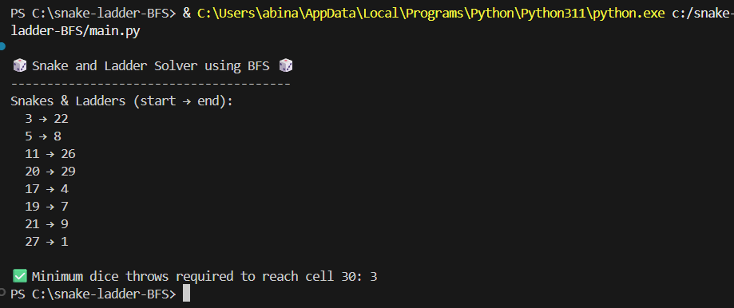
OUTPUT AND RESULTS
Output:
Minimum dice throws required to reach cell 30:3
Explanation: The program uses BFS to find the shortest route from start (cell 1) to finish (100). It efficiently avoids revisiting cells and always gives the minimum number of moves.

Slide 6
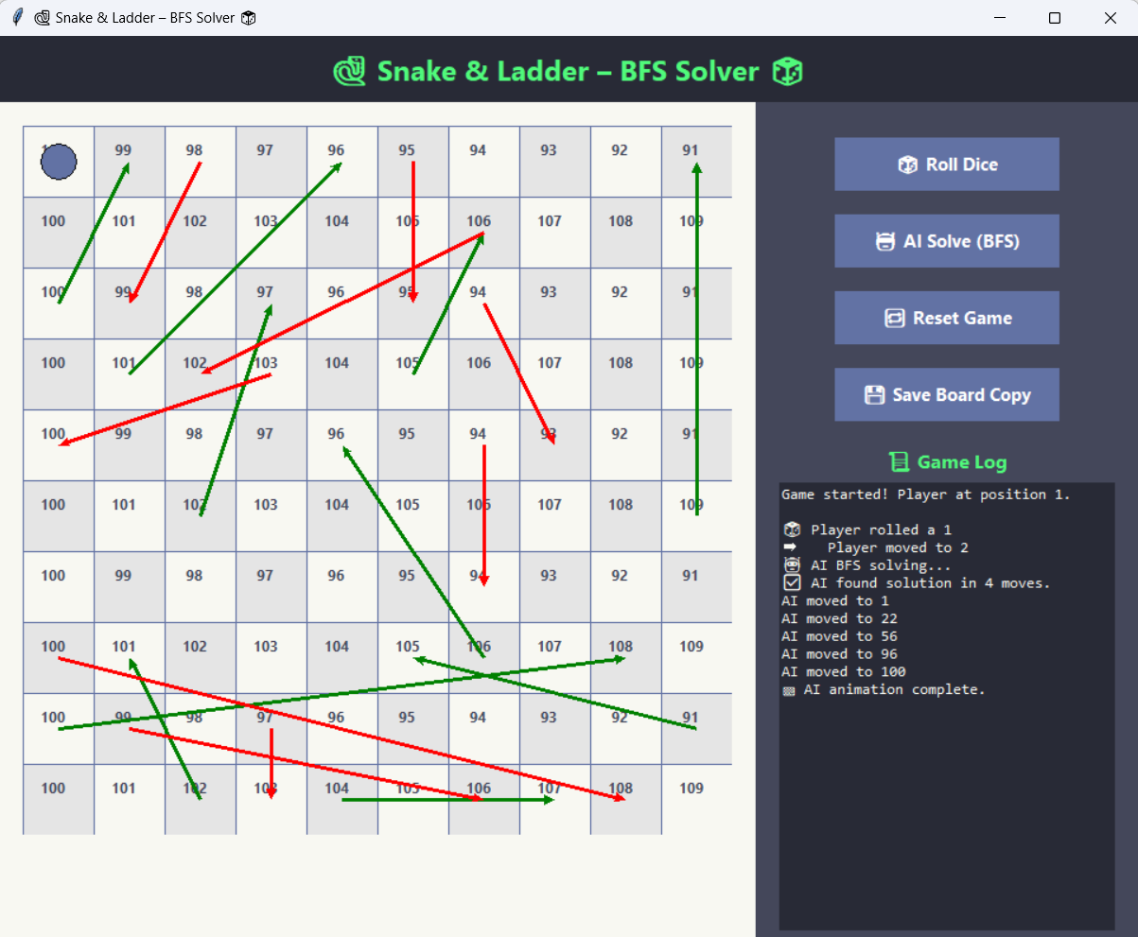
OUTPUT AND RESULTS

Slide 7
OUTPUT AND RESULTS
Results:
BFS successfully finds the optimal path on the Snake and Ladder board.
Guarantees minimum dice throws compared to brute-force methods.
Future Enhancements:
Add an interactive GUI for real-time play and visualization.
Support custom board sizes and advanced snake/ladder layouts.
Introduce probability-based AI for smarter move prediction.

Slide 8
REFERENCES
Russell, S., & Norvig, P. Artificial Intelligence: A Modern Approach, 4th Edition, Pearson, 2020.
Cormen, T., Leiserson, C., Rivest, R., & Stein, C. Introduction to Algorithms, MIT Press, 2009.
GeeksforGeeks. Breadth First Search or BFS for a Graph - https://www.geeksforgeeks.org/breadth-first-search-or-bfs-for-a-graph/
TutorialsPoint. Python BFS Algorithm - https://www.tutorialspoint.com/python_data_structure/python_bfs_algorithm.htm
Stack Overflow. Snake and Ladder BFS Solver Discussions - https://stackoverflow.com

